Slide 1
Europeana Migration
Share your [story] [family’s story] [community’s story] with Europeana and [insert the institution] - through objects like pictures, letters, postcards or recipes - at [insert venue & date/one of our collection days].
Sharing your own personal migration history can help us to tell a really big story - the story of Europe and the people who live here.
Here are some of the stories shared so far.

Slide 2
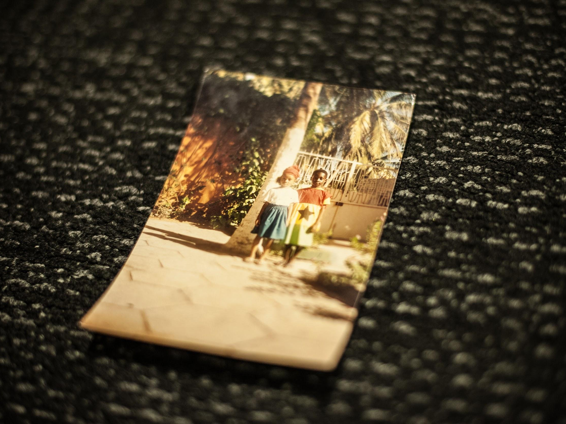
Marijke’s story
Dressed in flags

Slide 3
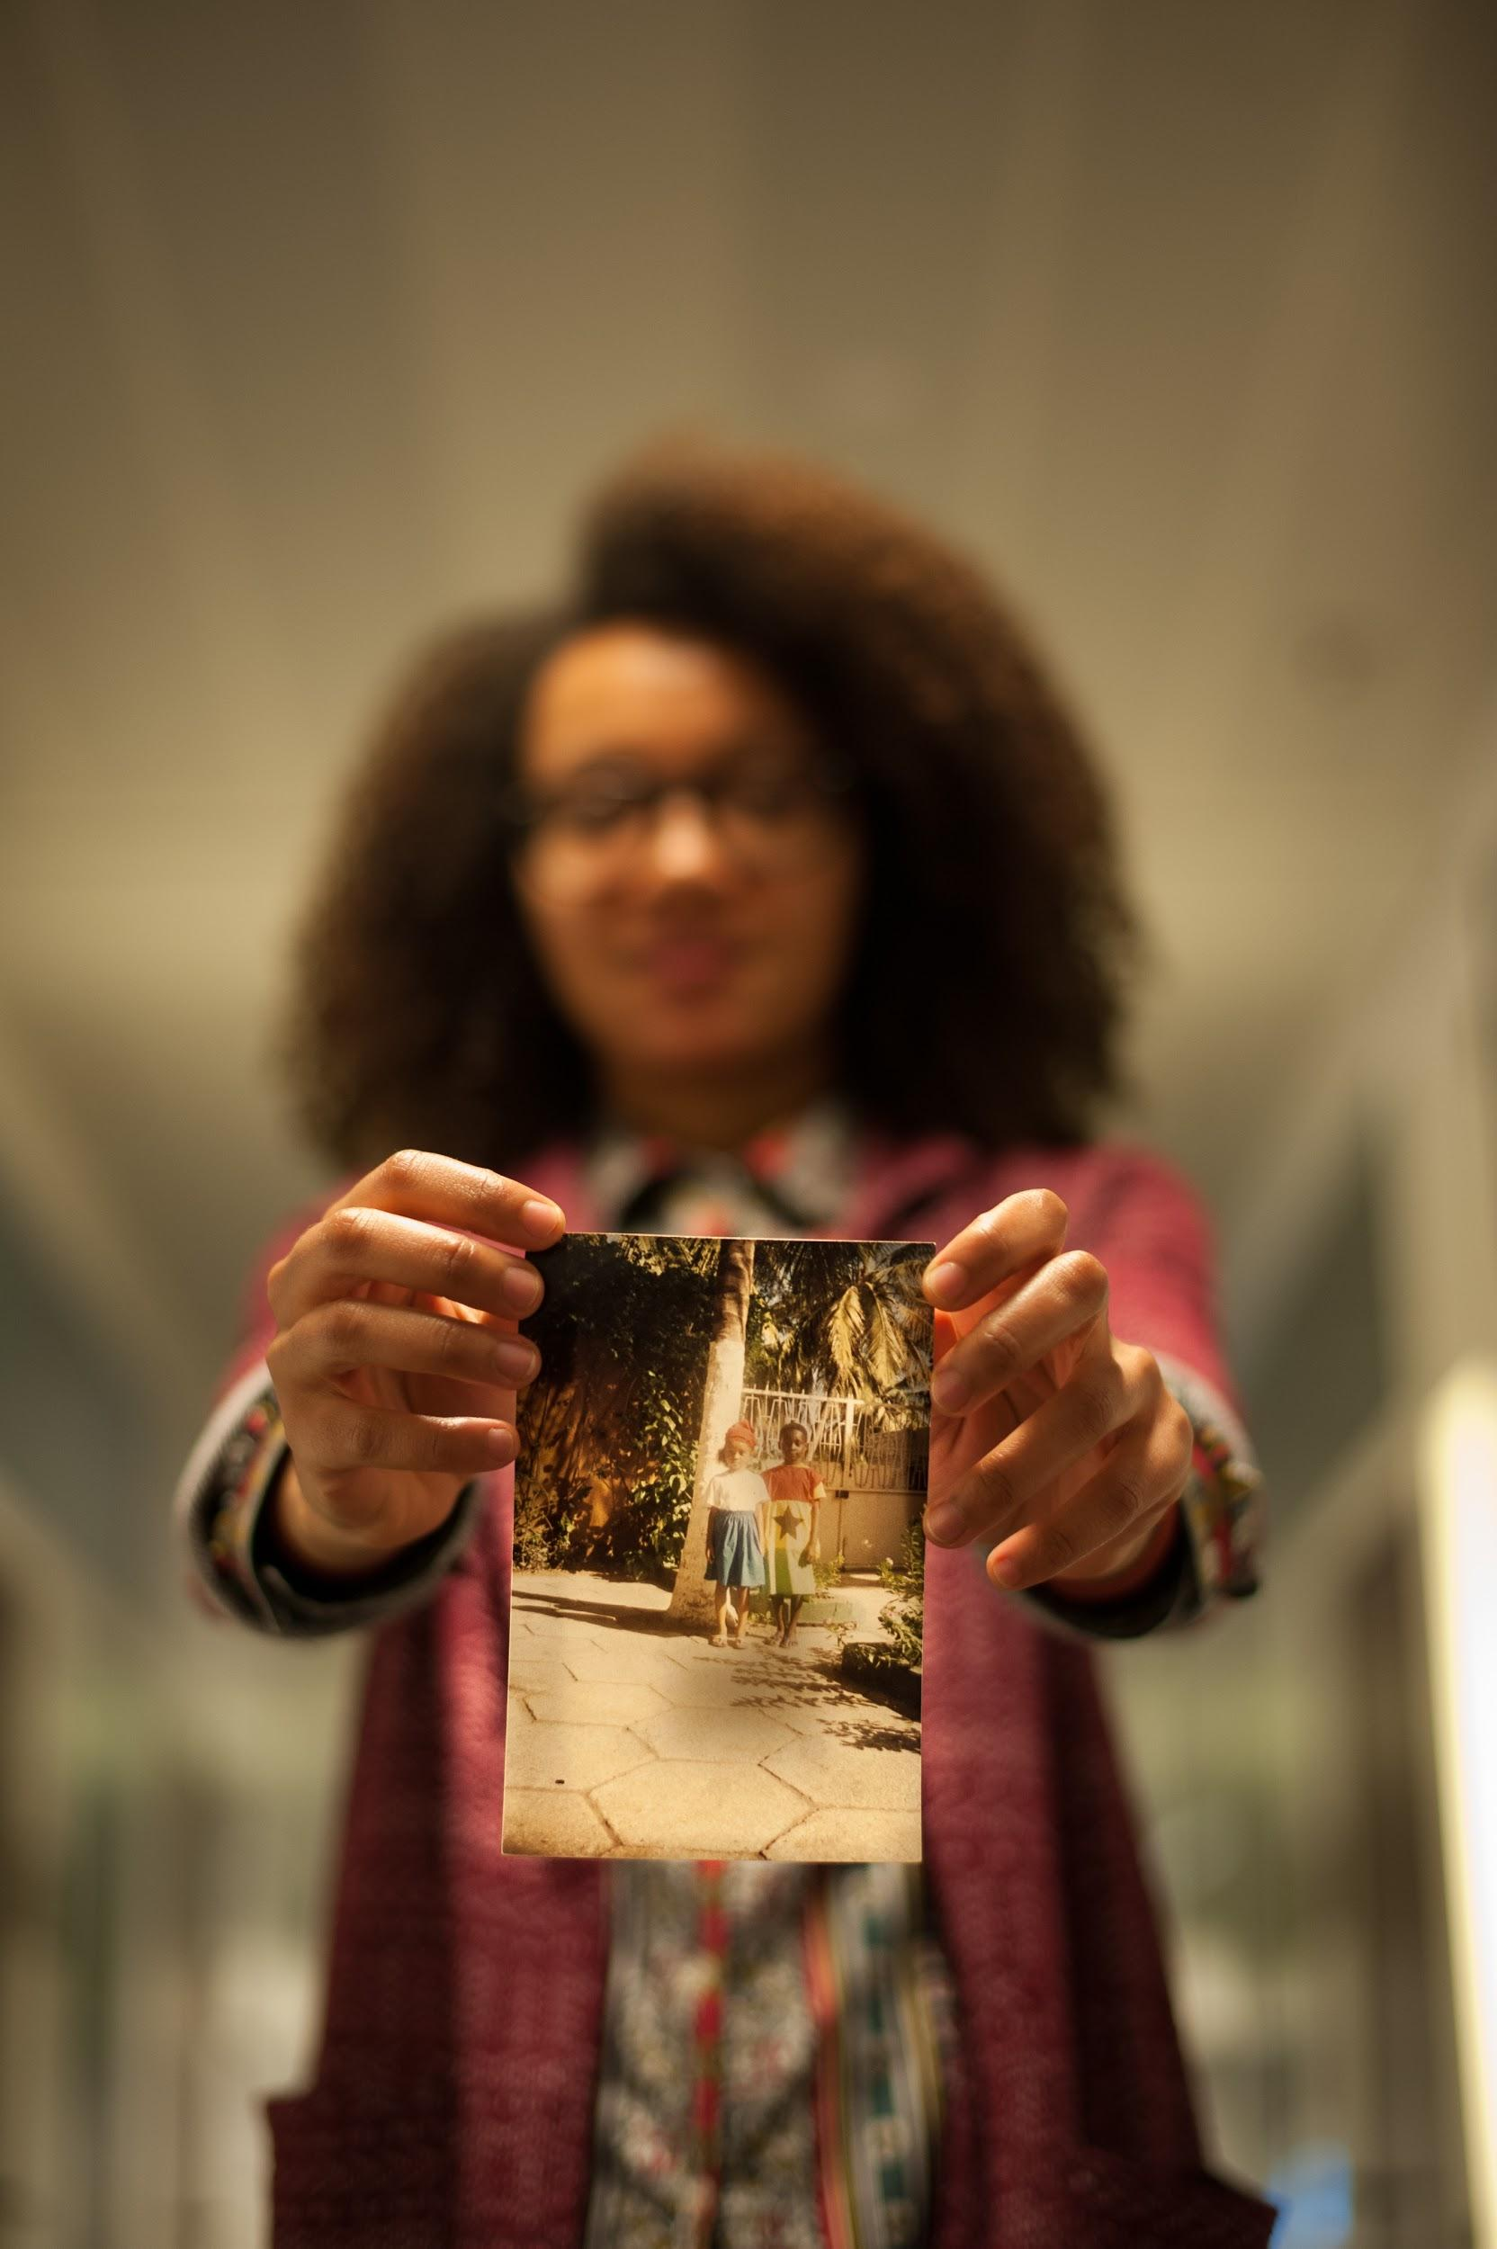
Marijke’s story
Dressed in flags - From Senegal to Italy, via Ghana and the Netherlands
‘For an International Day at my school in Senegal when I was about 6, my mother dressed my brother like the Ghanaian flag - she was from Ghana - and me like the Dutch flag - my father is Dutch.
This is a photo of us that day, and I have always treasured it. I took it when we moved to Italy and later, when I studied art in the Netherlands, it inspired a painting of my own.’

Slide 4
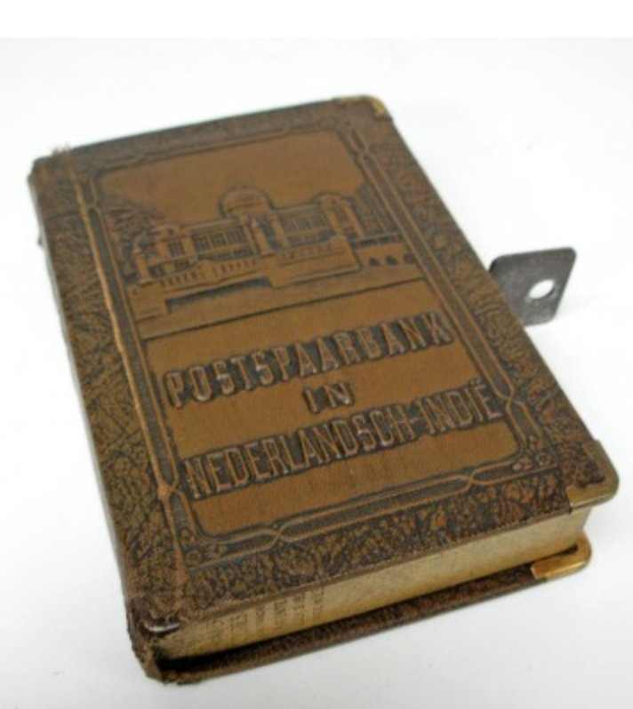
David’s story
Dressed in flags

Slide 5
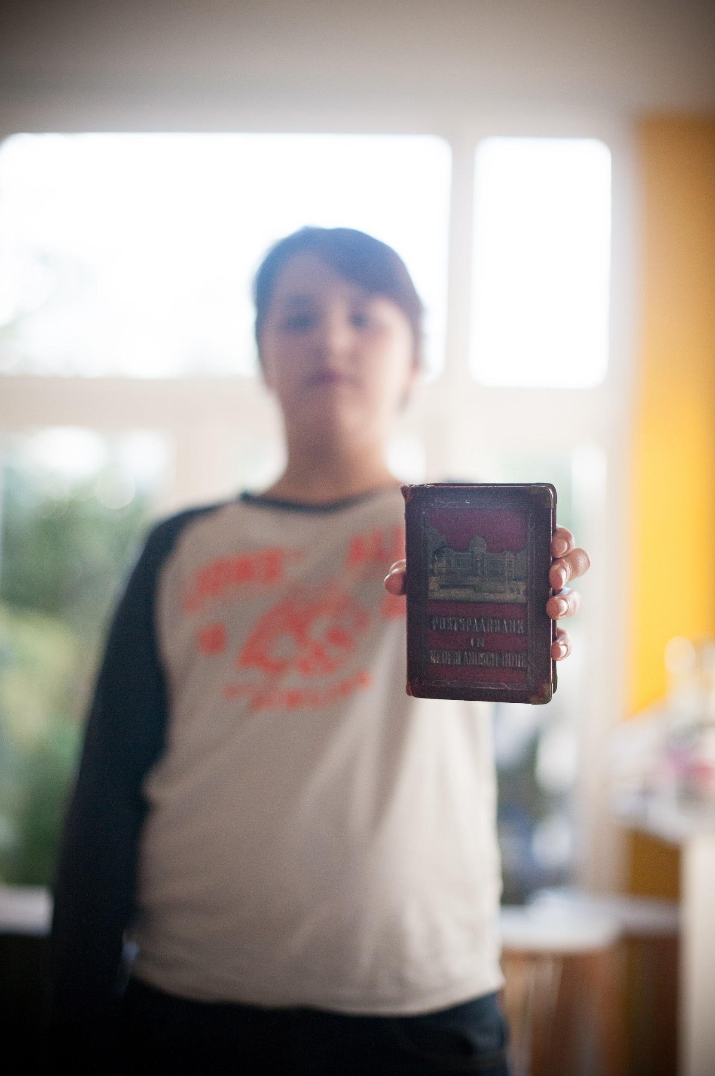
David’s story
The Money Box - from the Dutch East Indies to the Netherlands
‘My grandfather migrated back to the Netherlands from the Dutch East Indies (modern Indonesia) after the Second World War. The story of his life, as told in his baby-book, changes dramatically in December 1941 when war broke out.
My grandfather’s father was taken to a prisoner of war camp, my grandfather and his mother to a separate camp. They survived and returned to the Netherlands along with this money box which still reminds us of my family’s life in the Indies.

Slide 6
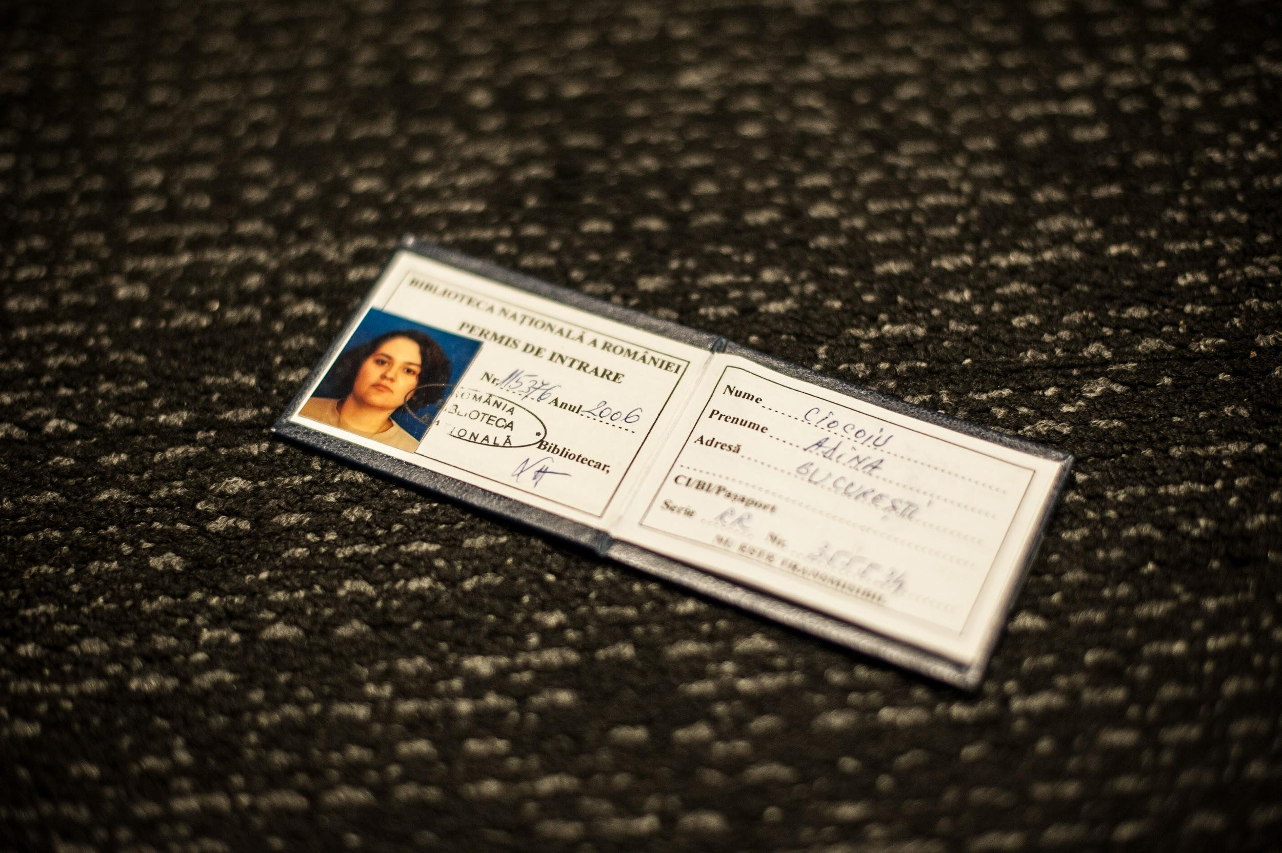
Adina’s story
Dressed in flags

Slide 7
Adina’s story
For the love of libraries - from Romania to the Netherlands
‘These are library cards. Some from my university years in my home country of Romania and some from libraries I joined during my studies abroad - Norway, Estonia, Italy, and the Netherlands.
The time I spent in these libraries helped develop my passion for books and took me to places I never imagined. They fuelled my desire to learn about the world and to enjoy both its challenges and its beauty.’

Slide 8
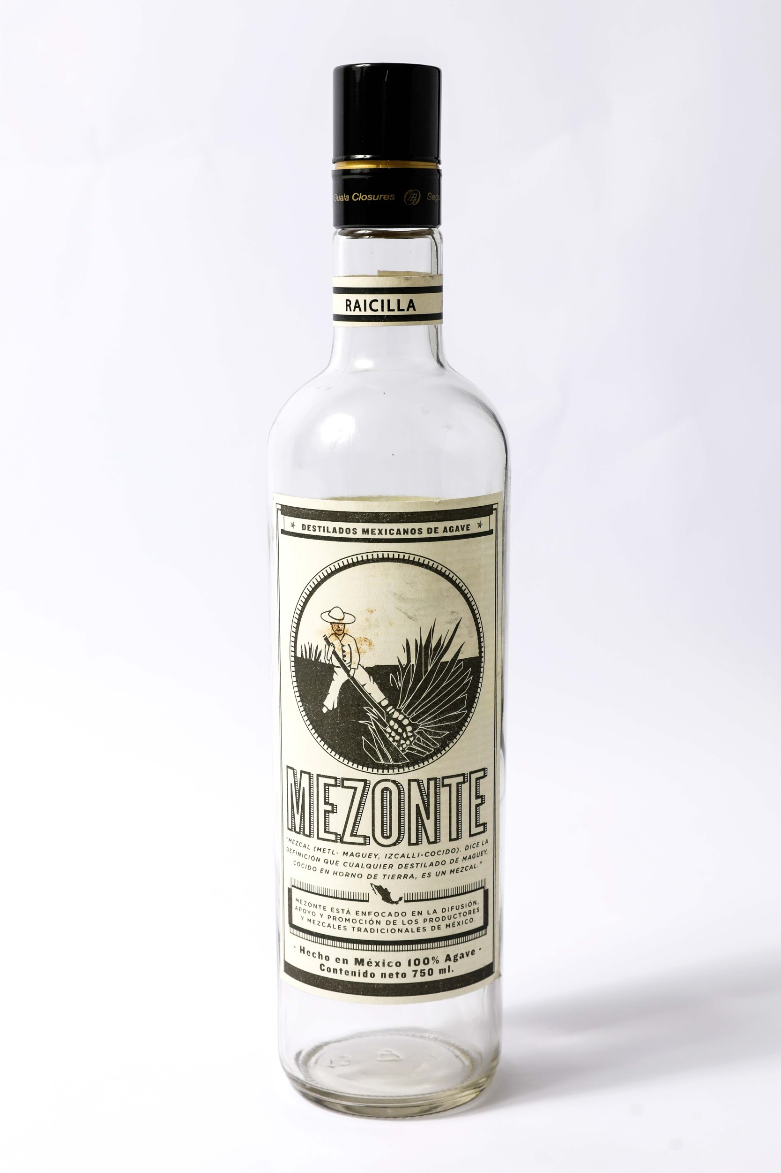
Ana’s story

Slide 9
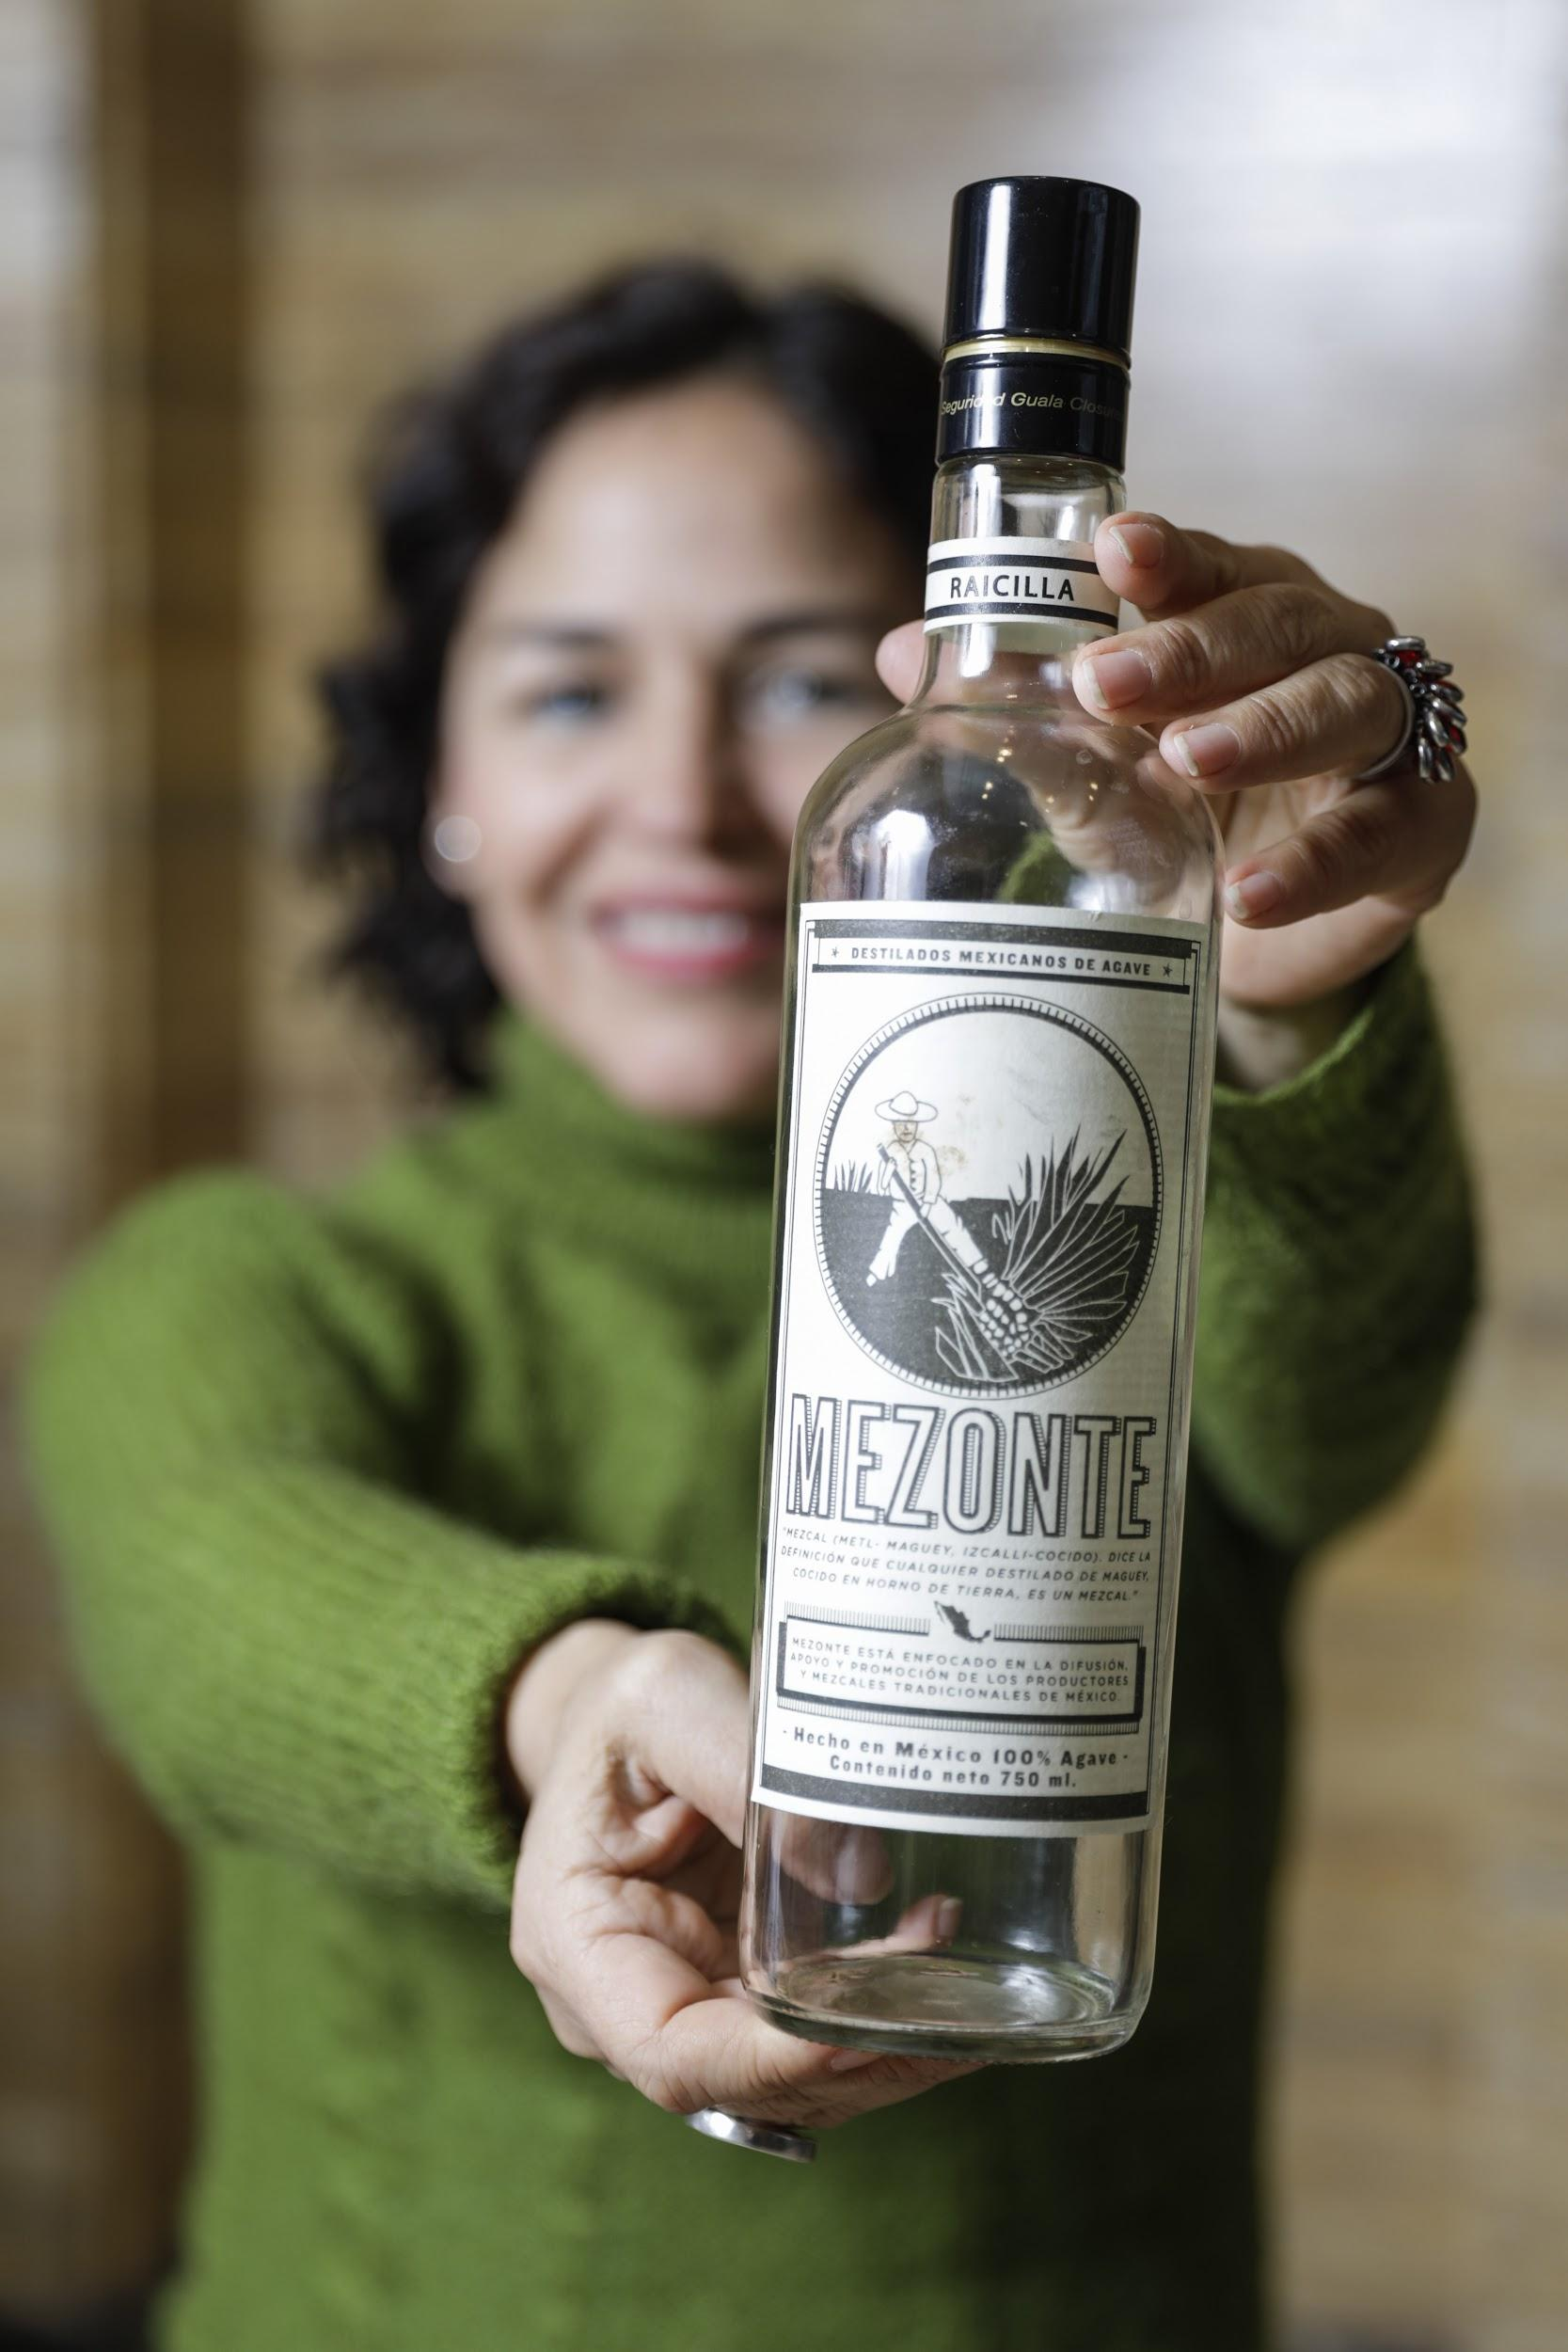
Ana’s story
The mezcal spirit that brought me to Europe - From Mexico to Brussels
‘This bottle contains mezcal raicilla, the ancient brother of tequila. I am a migrant because of this spirit.
In 2002, I came to Europe to study sustainable production of artisanal beverages. If it wasn't for studying this, I would have stayed at home in Mexico.
I am researcher in botany, specialising in these agave plants which are used for cooking in my country for 11,000 years.’

Slide 10
Henning’s story
Dressed in flags

Slide 11
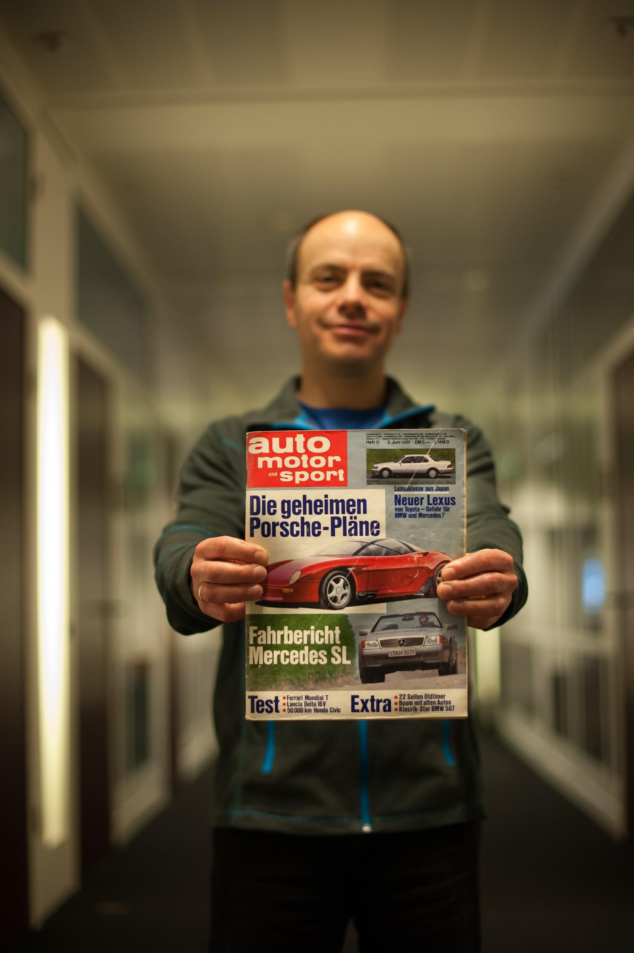
Henning’s story
From East to the West Germany - leaving a country that doesn't exist anymore
‘On 1 June 1989, age 16, I left the German Democratic Republic with my family. Just a few weeks before the Iron Curtain began to fall, we got formal approval to leave from the authorities.
The next day, we arrived in Darmstadt where my grandparents lived. My grandfather gave me 10 Deutsche Mark and I spent half of it on a magazine. I was shocked how expensive it was. But I was happy with what I got. And I still have it, with the date ‘2 June 1989’ printed on the cover.’

Slide 12
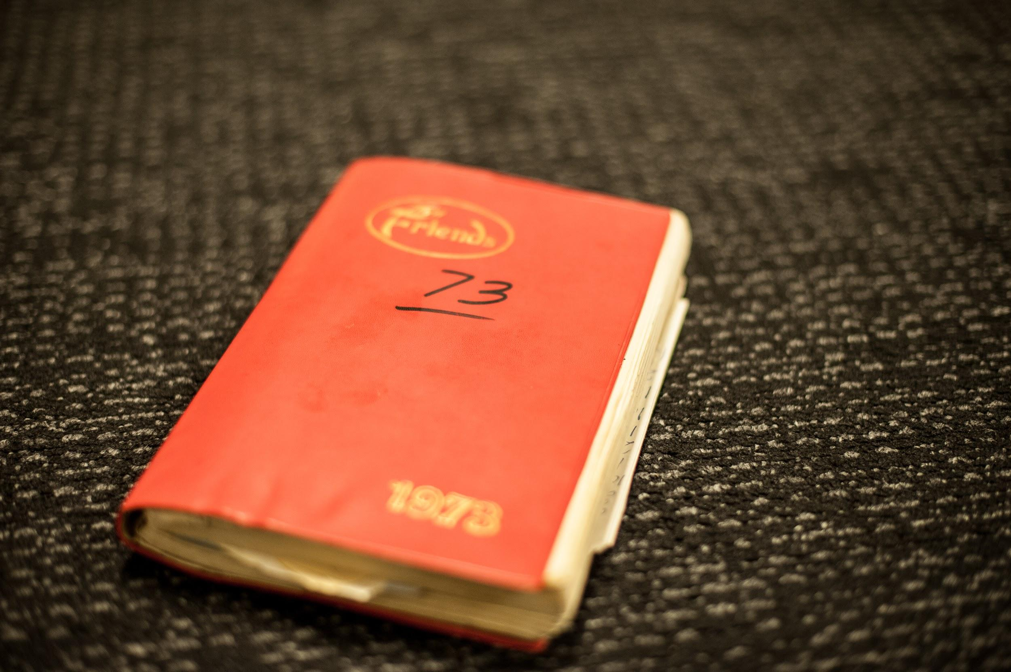
Zubia’s story

Slide 13
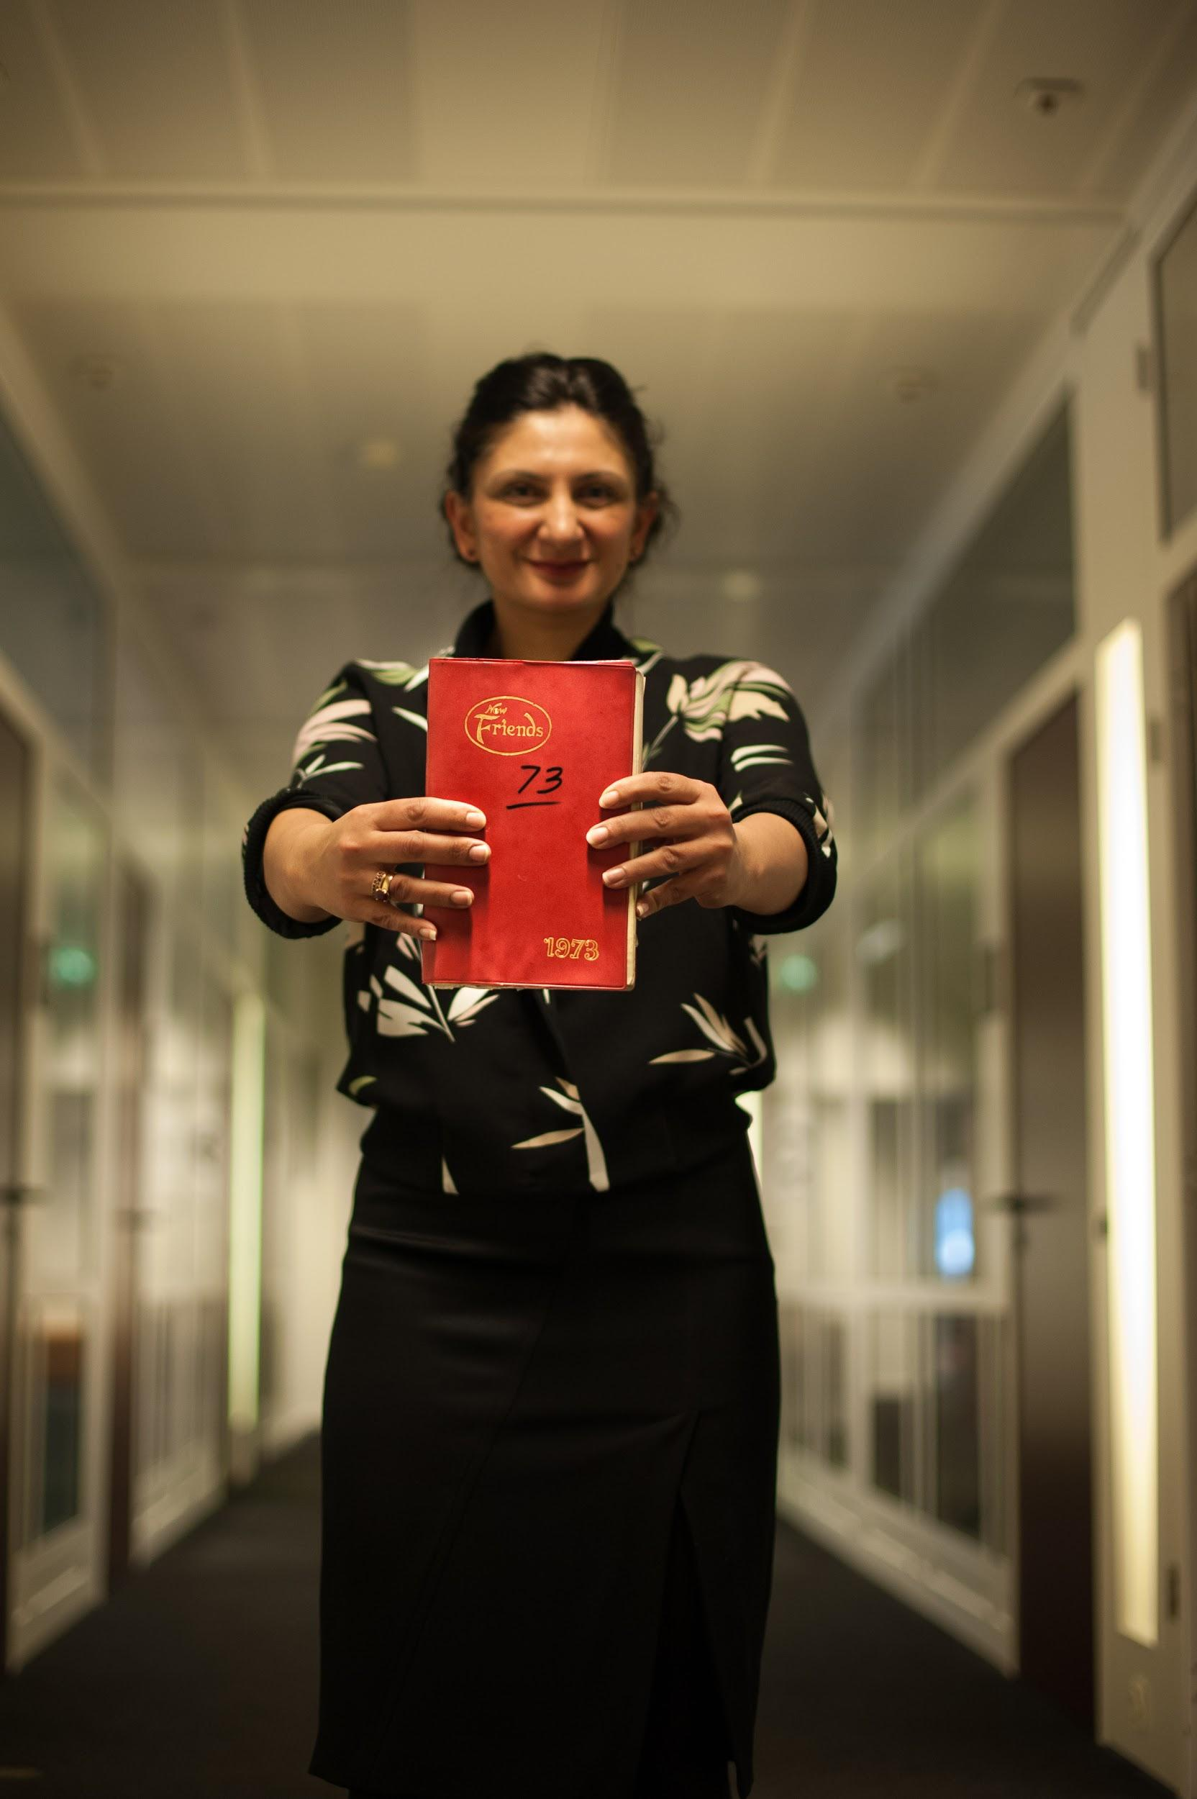
Zubia’s story
The Red Diary - from India to Italy
‘Both my parents were born in India. They moved to Pakistan after its creation in 1947 during Partition. In 1973, my father moved to Rome, Italy. This is his work diary from that year.
In it are his daily work notes along with names of people he met, friends he made and observations about his everyday work. It also contains the love letters my mom and him exchanged during that year. We joined him in Rome when I was six months old.’

Slide 14
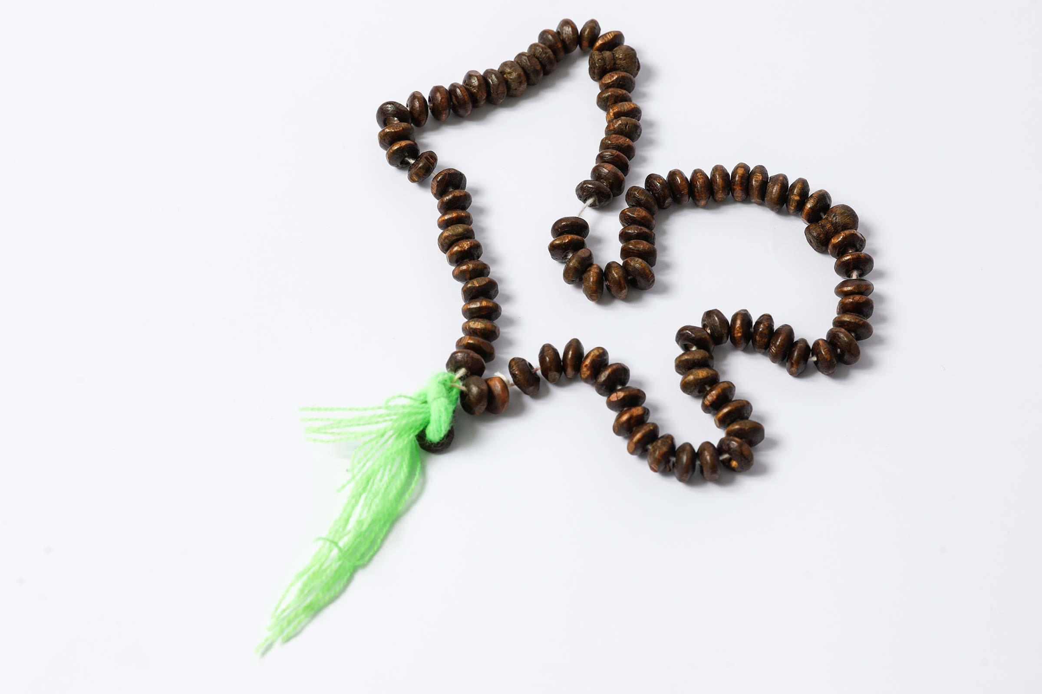
Walid’s story

Slide 15
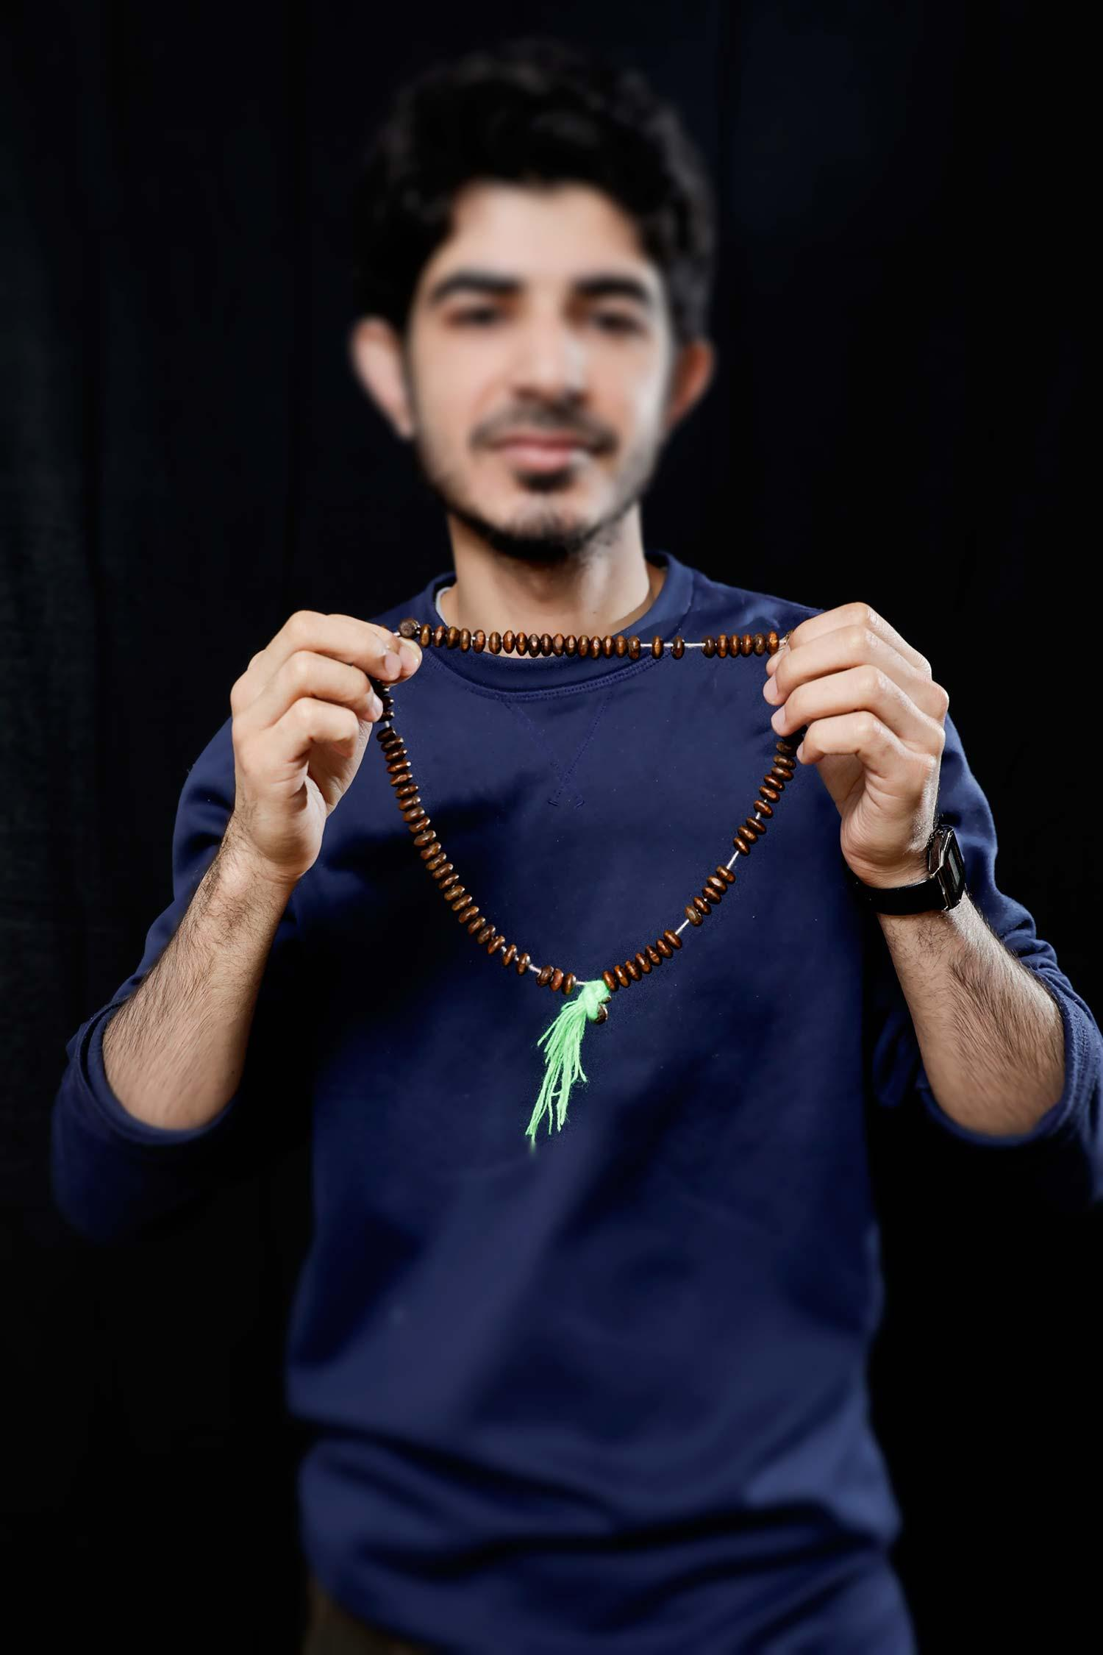
Walid’s story
My prayer beads from home - from Syria to Brussels
‘My name is Walid and I am a refugee from Idlib, Syria.
These Misbaha prayer beads were given to me as a goodbye present by my friend when I left my hometown. I first moved to a port city Latakia in Syria and stayed there for nine years.
I lived with my family but when the war continued, we moved to Lebanon and I worked there for nine months to finance our voyage to Europe. I moved to Brussels with my mother in 2015.’

Slide 16
Europeana Migration
In partnership with [Insert Institution name] and migration museums across Europe, during the 2018 European Year of Cultural Heritage Europeana is inviting people young and old to be part of its project to build an online collection dedicated to migration.
Your story is part of Europe’s rich and shared history of migration, and now it can be recorded for the future, and made freely available for anyone to discover and use for education, research, inspiration and pleasure.

